Slide 1
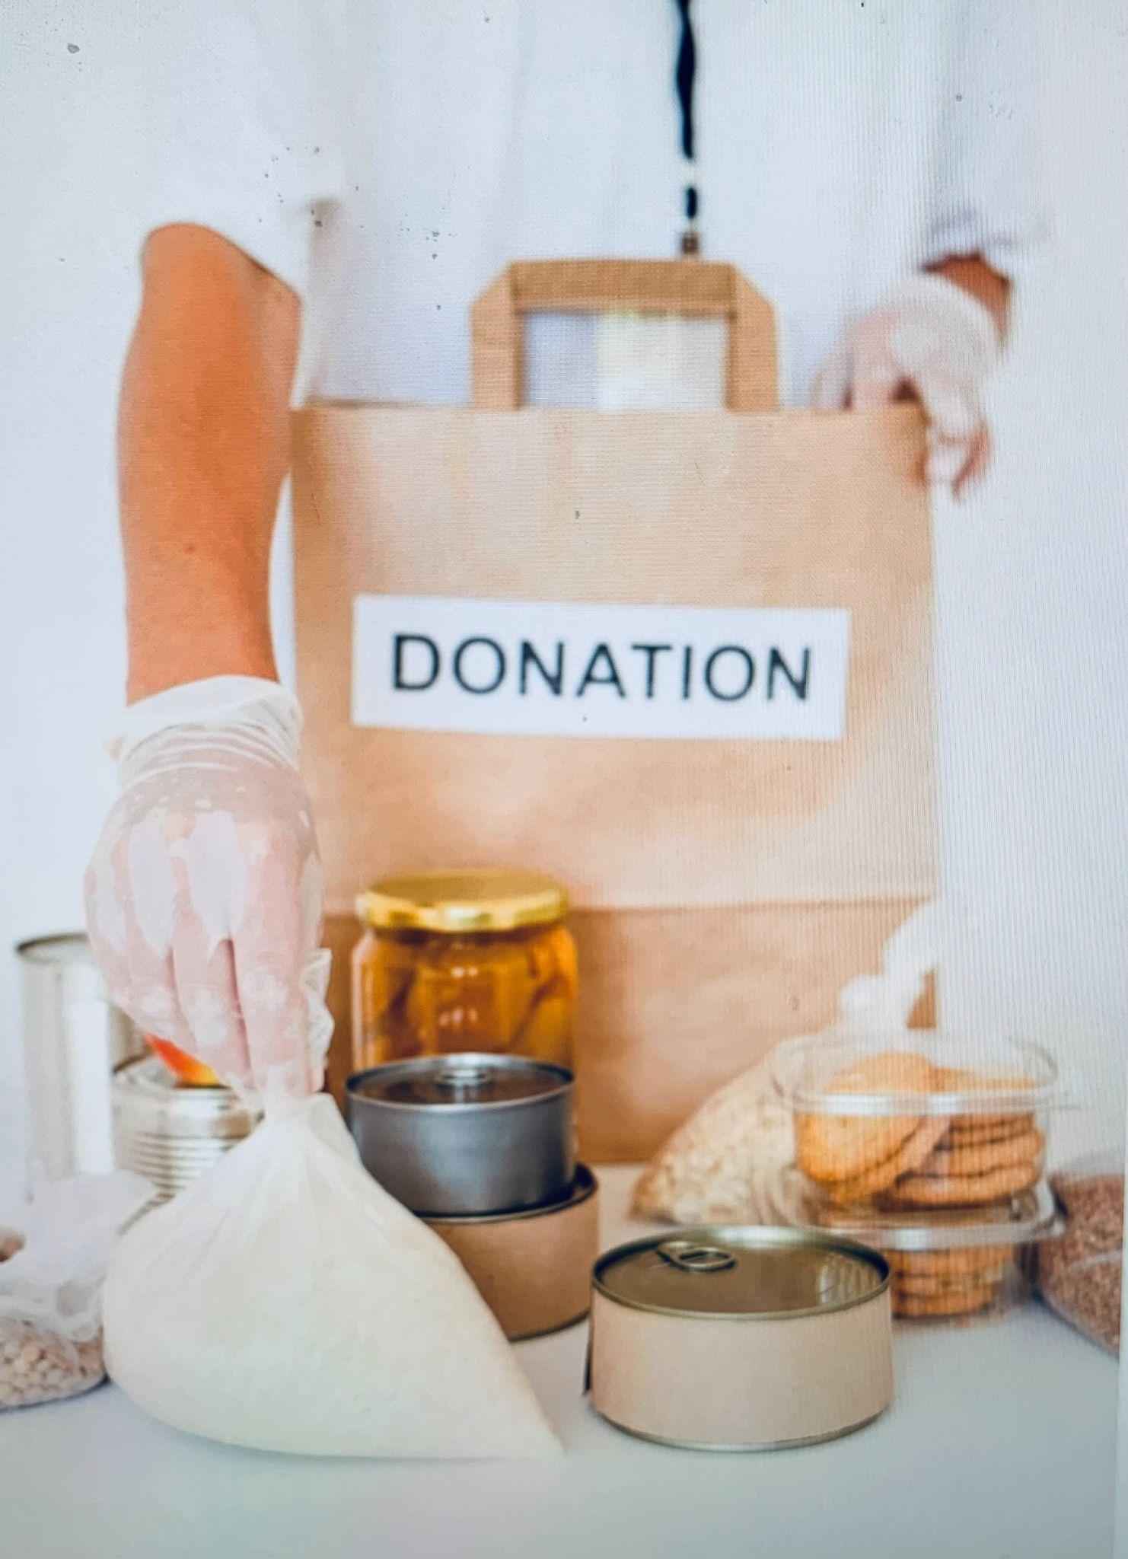

Edible Food Recovery - City of Glendale -
Food donation programs available for businesses located in the City of Glendale
Presented October 12th, 2022

Slide 2
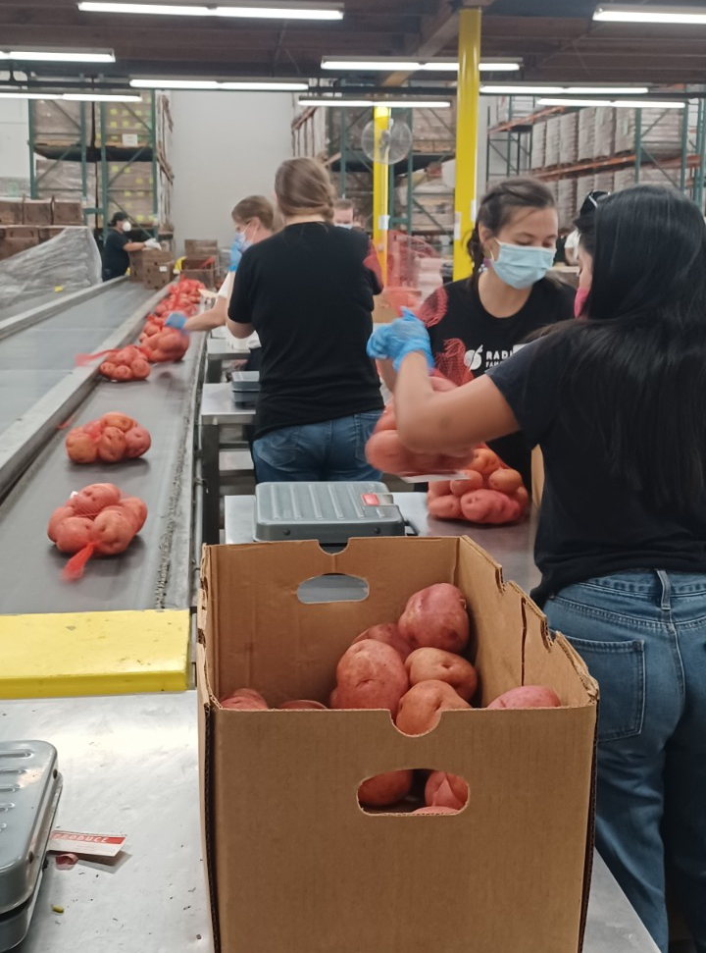

AGENDA:
The Problem – Wasted Food
The Solution – California Senate Bill 1383
A Closer Look at Senate Bill 1383
Resources for Businesses
Q&A
- Defining “edible food” and liability
- Businesses required to comply
- Business requirements
- Benefits of food donation
- ReCREATE: Business Technical Assistance
- FoodCycle LA: Food Service Provider
- Careit: Free Data Tracking App

Slide 3
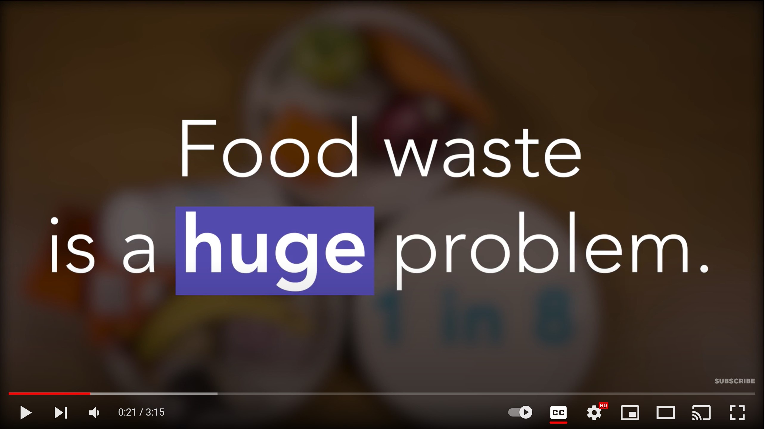
Video link: https://www.youtube.com/watch?v=OJzGLKeD1DU&t=2s

Slide 4
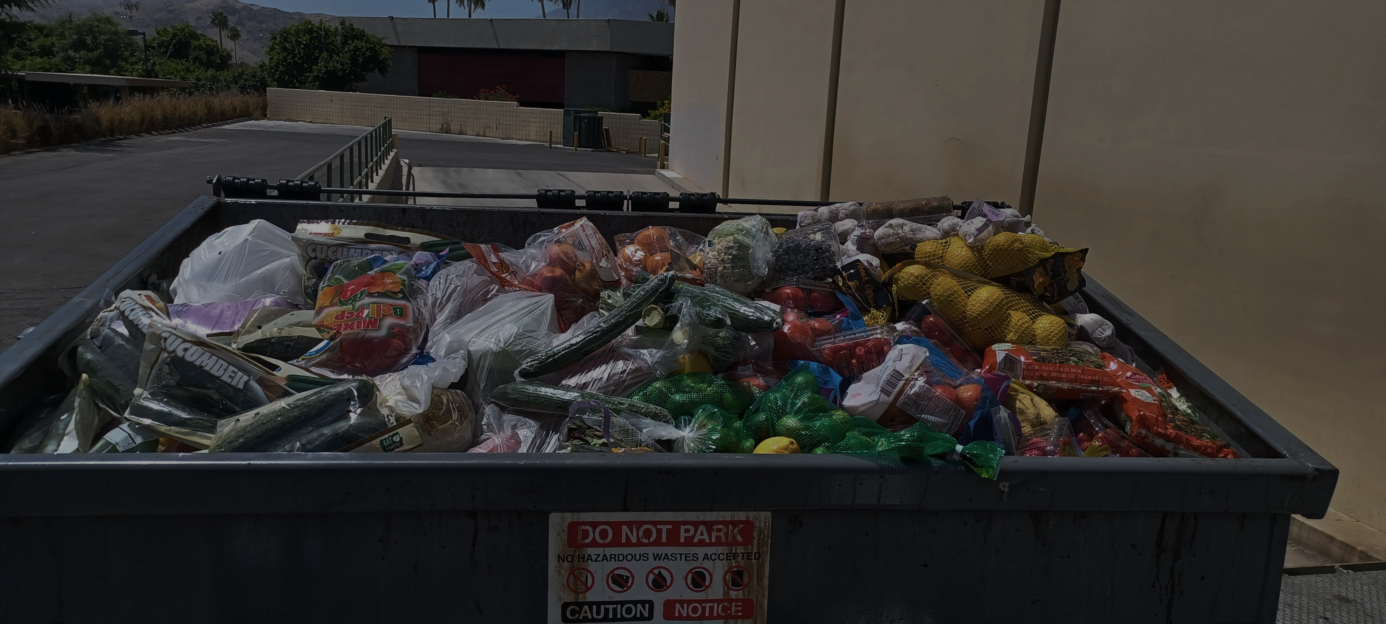





The Problem: Wasted Food
Food is overproduced
People are hungry and need food
Stores need to maintain expectations of quality
Food goes to landfill: - Methane is released
- Landfill space is limited
Food gets wasted:
- Past sell by date
- Damaged
- Extra stock

Slide 5
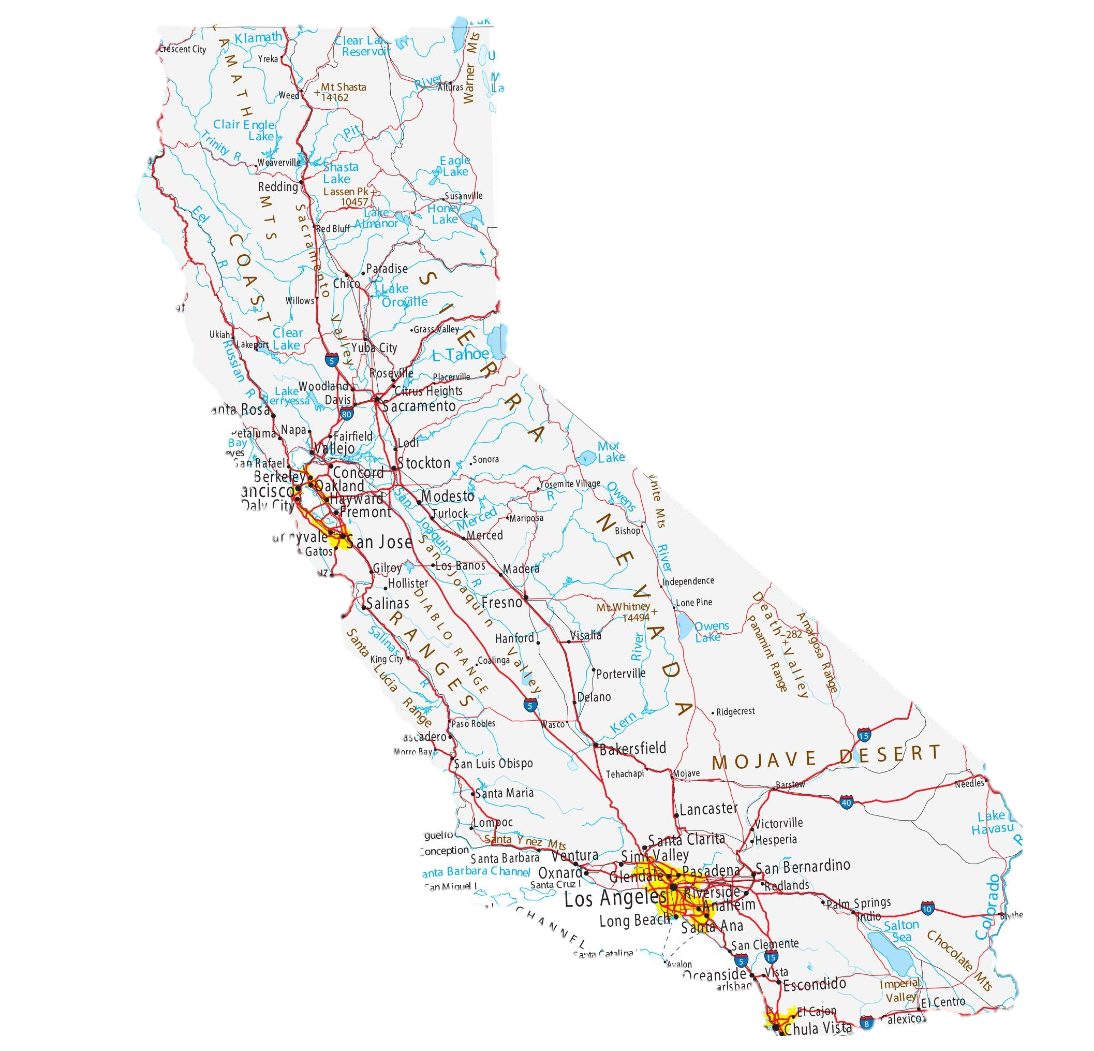
The Solution: Senate Bill 1383
California adopted Senate Bill 1383 (SB 1383) to reduce greenhouse gas emissions from edible food and inedible organic waste currently going to landfill (being “thrown away”).
The law strengthens existing state laws that commits all California communities to reducing emissions and combating climate change.
January 1, 2022
January 1, 2025
Regulations Take Effect
20% of Currently Disposed Edible Food Must Be Recovered For Human Consumption
75% Reduction In Landfilled Organic Waste

Slide 6


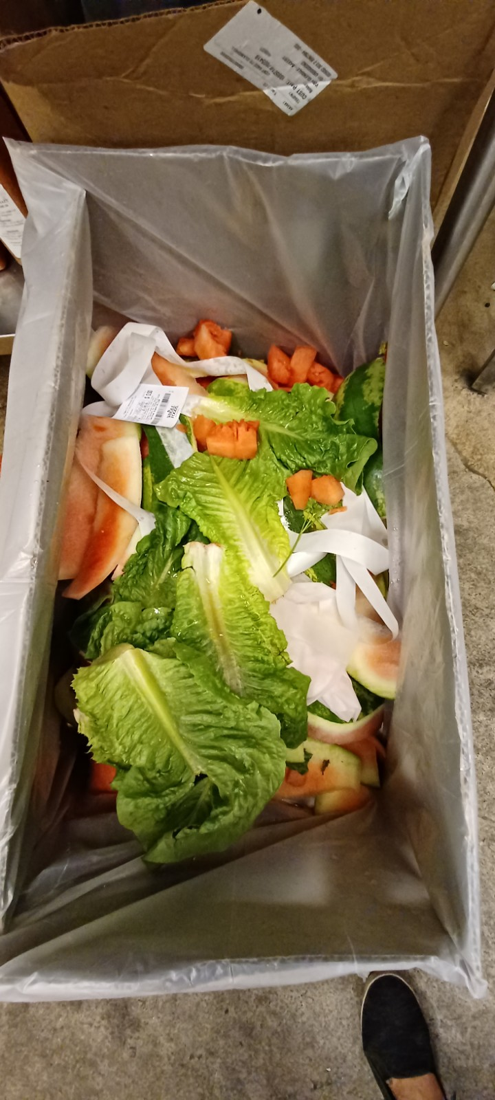
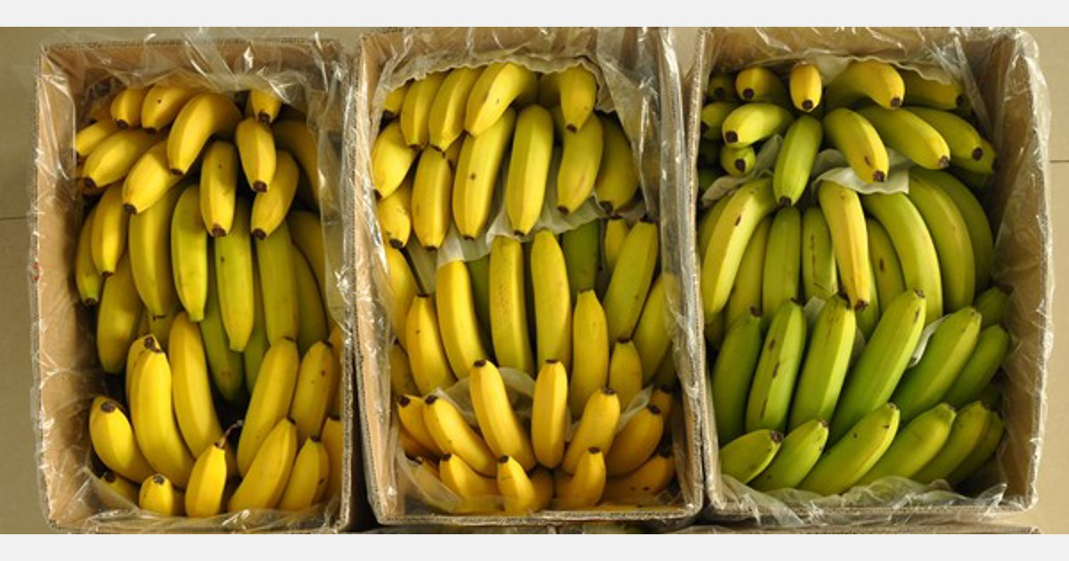
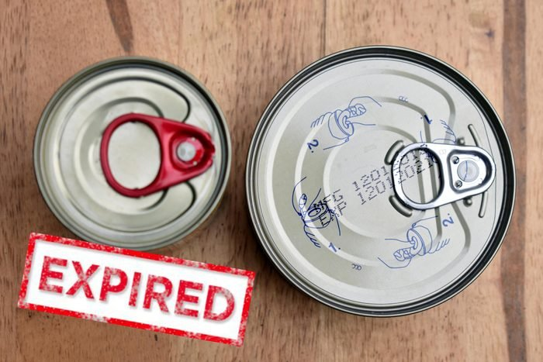

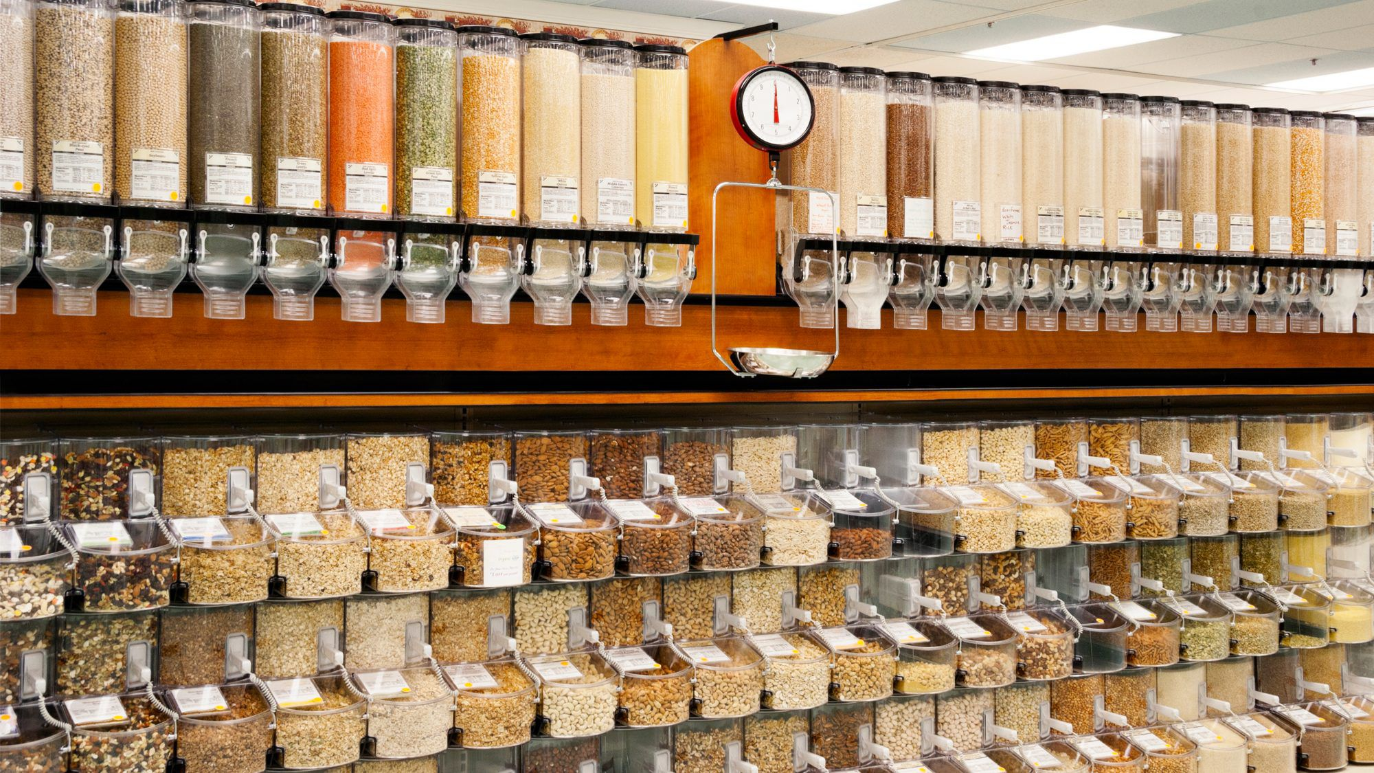
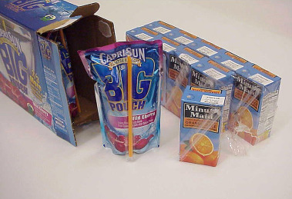
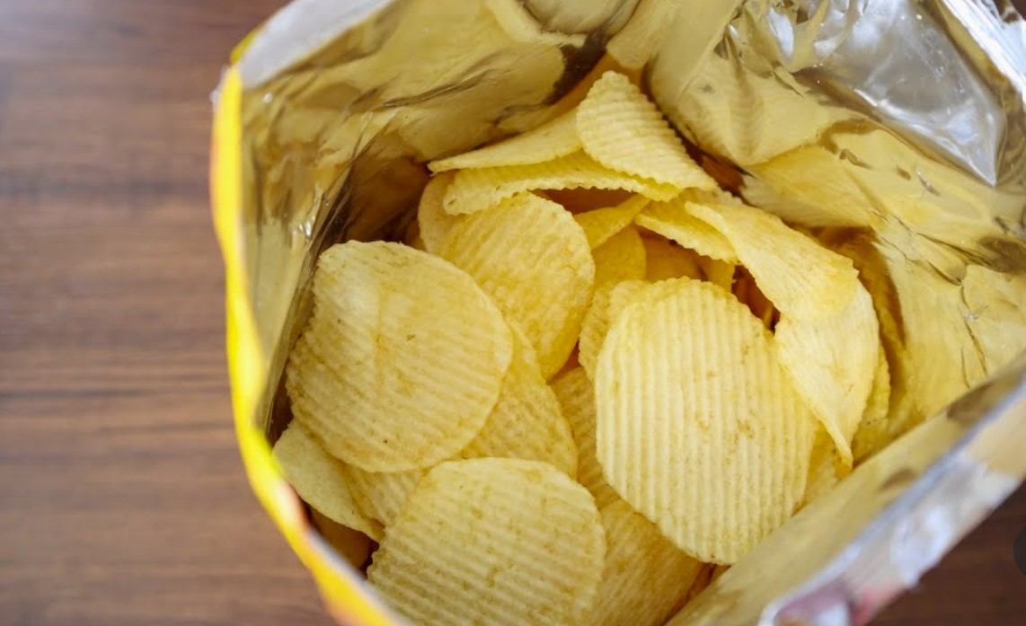
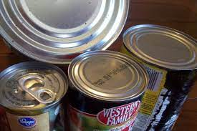

WHAT IS “EDIBLE FOOD”?
Yes | No
Surplus food
Expired / past “sell by” food
Organic waste (food scraps)
Food not fit to be consumed
Bulk food
Damaged boxes
Open packaged food
Bulging cans

Slide 7
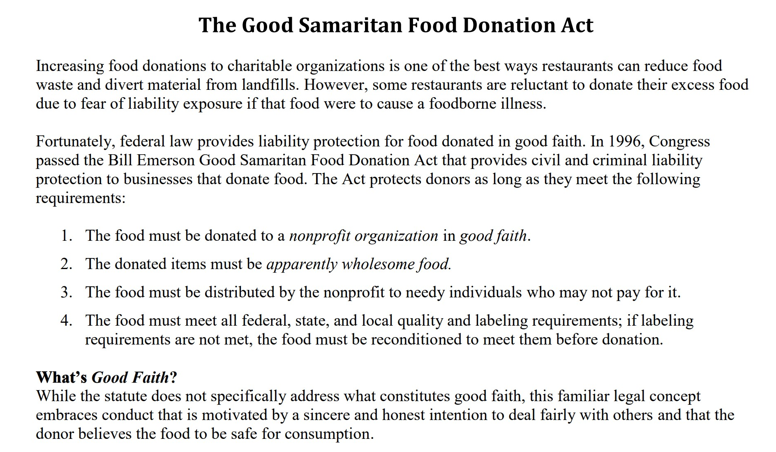
IS FOOD DONATION RISKY?
NO, YOUR BUSINESS IS PROTECTED LEGALLY (BOTH FEDERALLY AND AT THE STATE LEVEL)

Slide 8
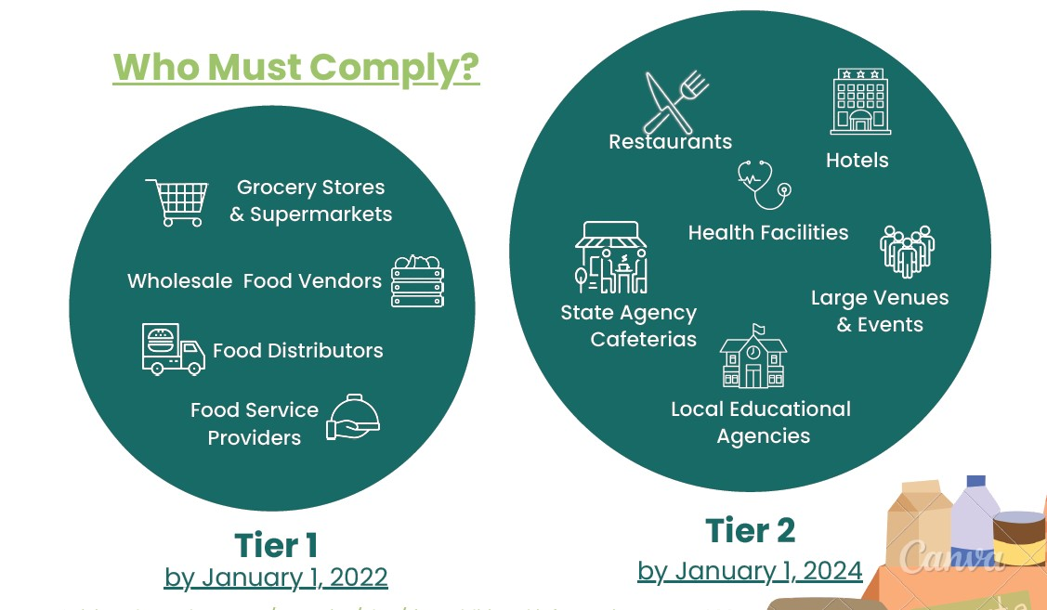
IS YOUR BUSINESS REQUIRED TO DONATE FOOD?
IF YOUR BUSINESS FALLS INTO ONE OF THESE CATEGORIES, THEN YES
*Specifications exist for some business types – check CalRecycle definitions for more information

Slide 9



WHAT DOES YOUR BUSINESS NEED TO DO TO BE COMPLIANT?
Establish a contract for food donation with an organization or service that can accept it
Keep records of food donations
Types of food donated
Frequency
Quantity (in lbs)
Contact info of org/service
Donate ALL edible food that would otherwise be thrown away
1
2
3

Slide 10
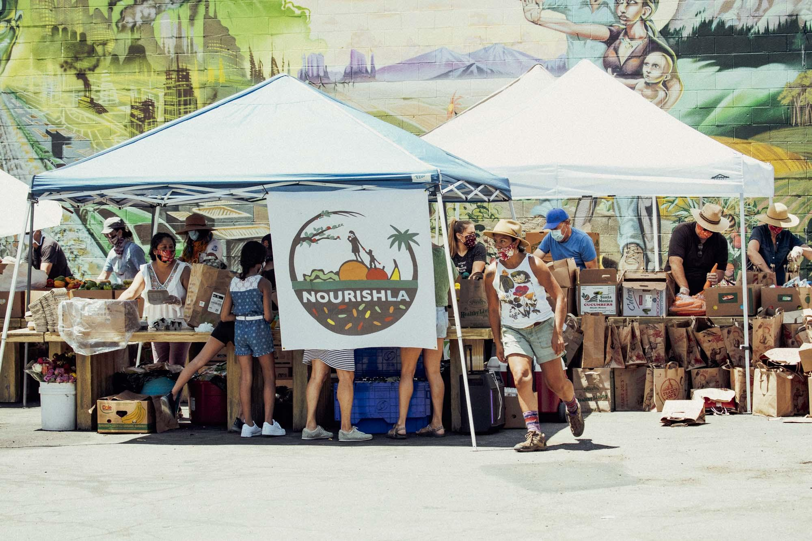
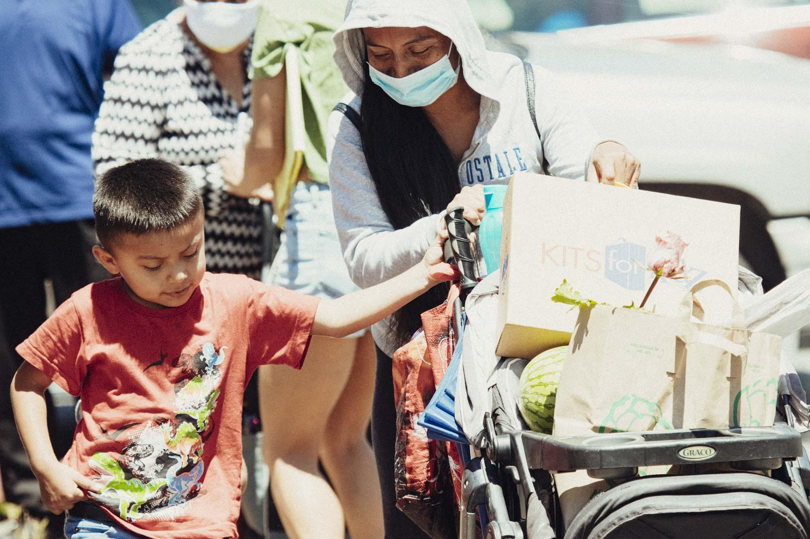
BENEFITS OF FOOD DONATION:
Preserve landfill space
Reduce greenhouse gas emissions
Positively mitigate climate change
Feed hungry people
Support low income families
Support local nonprofit organizations
Tax deductions available

Slide 11
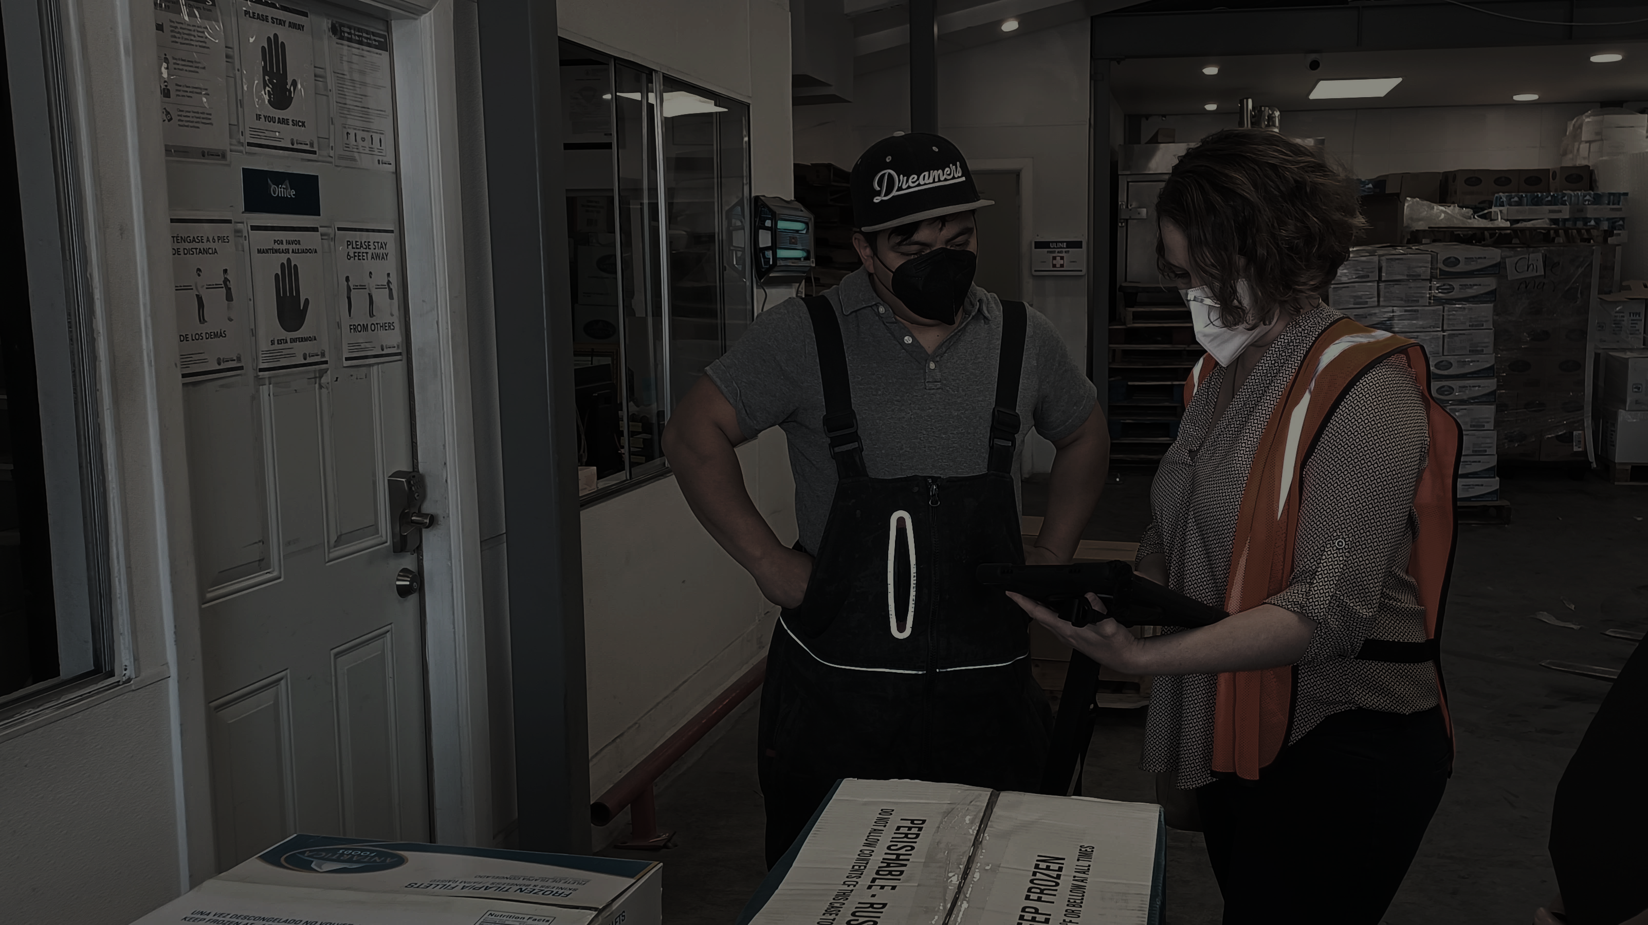



ReCREATE: Business Technical Assistance
Resources for Businesses
Provide education and outreach
Staff training on how to use Careit, connect with FoodCycle LA
Track compliance
FoodCycle LA: Food Service Provider
Collection and transportation of food
Volunteers for accepting food donations
Connections to food recipients
Careit: Free App for Food Donations
Automatically generates contracts for food donations
Recordkeeping and other compliance data tracking
Easily provides a method for donating food

Slide 12
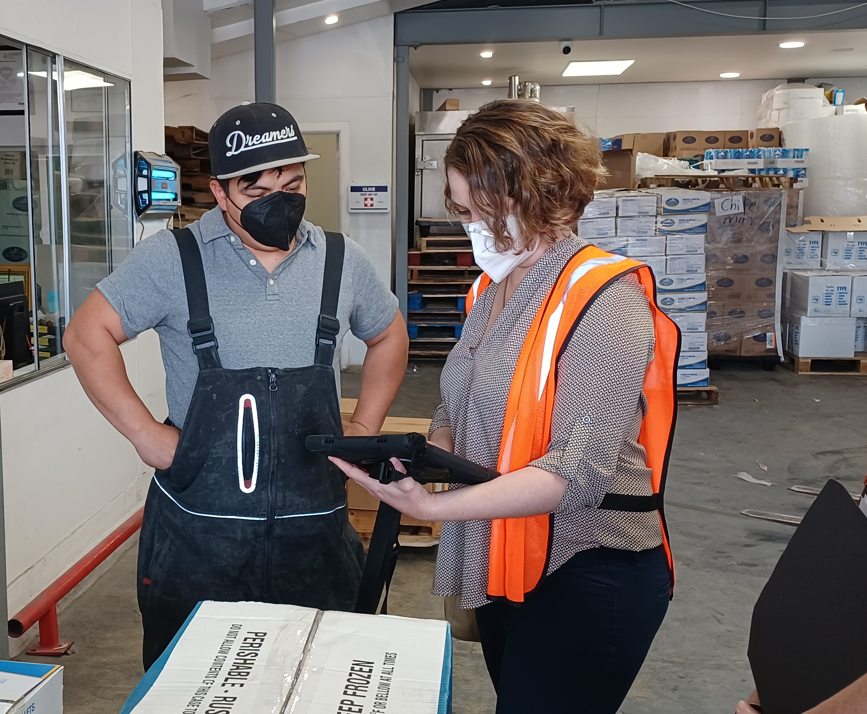
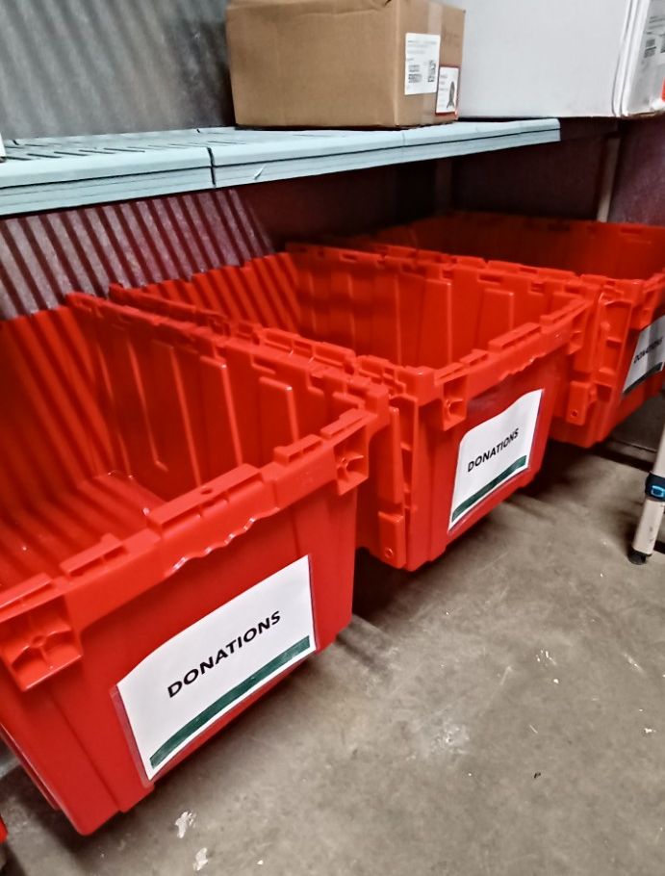
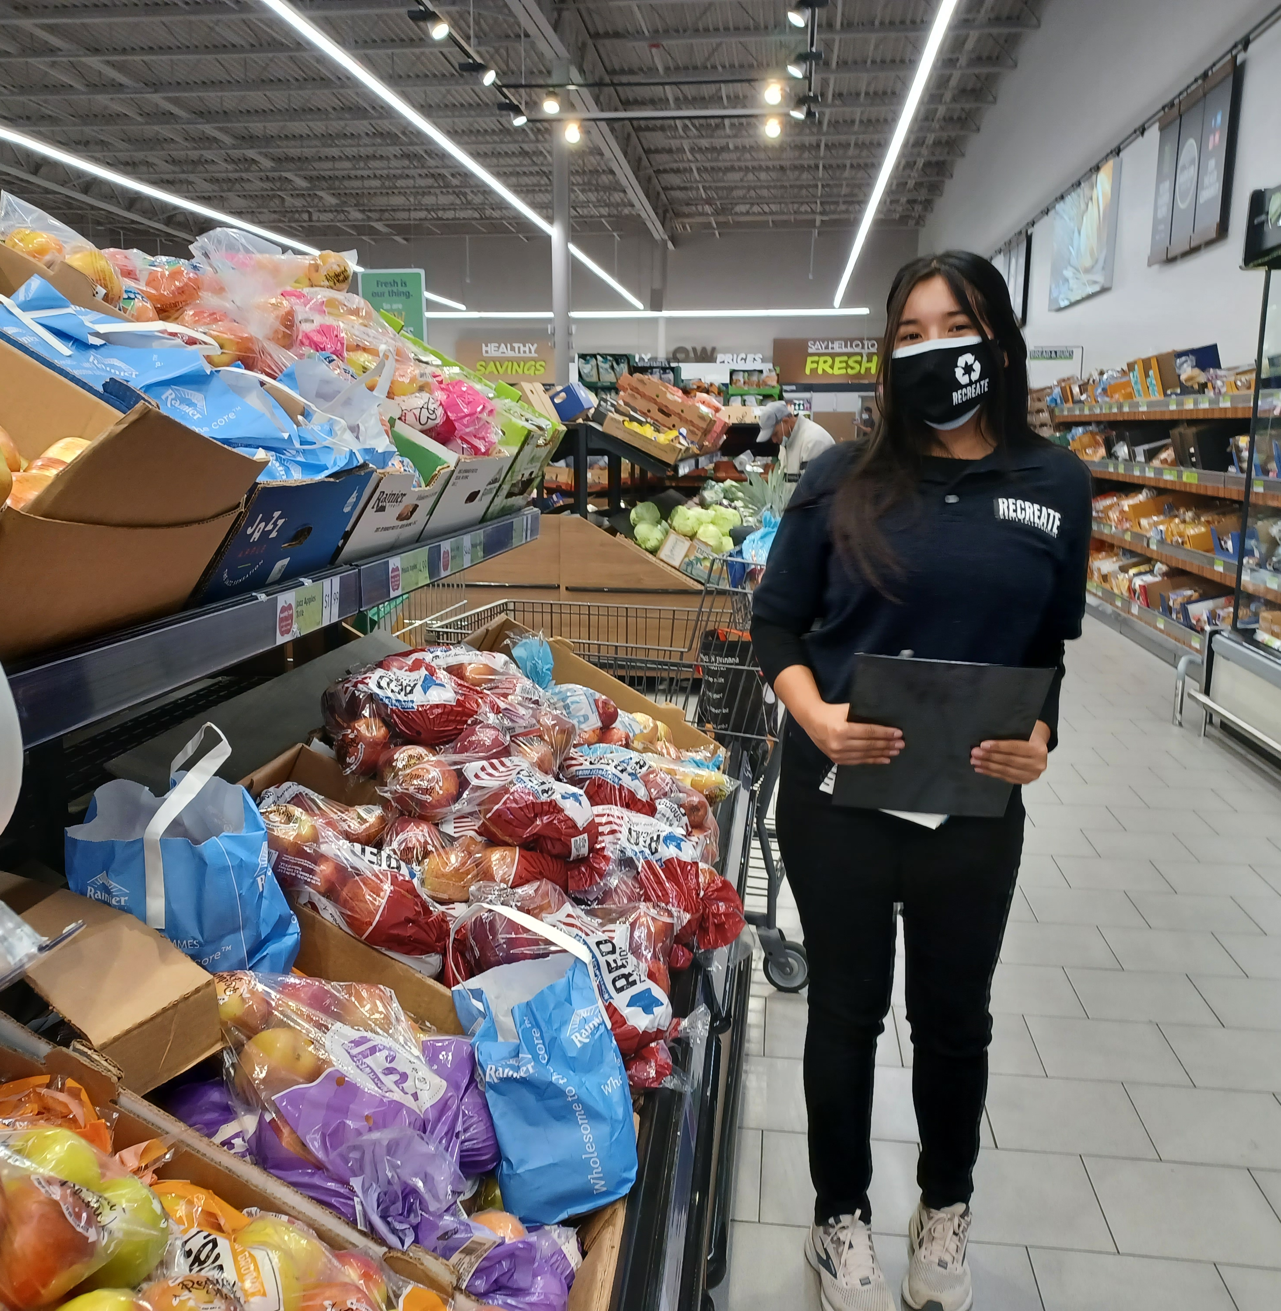
RESOURCES AVAILABLE: ReCREATE
Team of technical assistance consultants contracted by the City of Glendale to help businesses with their food donation programs – free of charge!

Slide 13
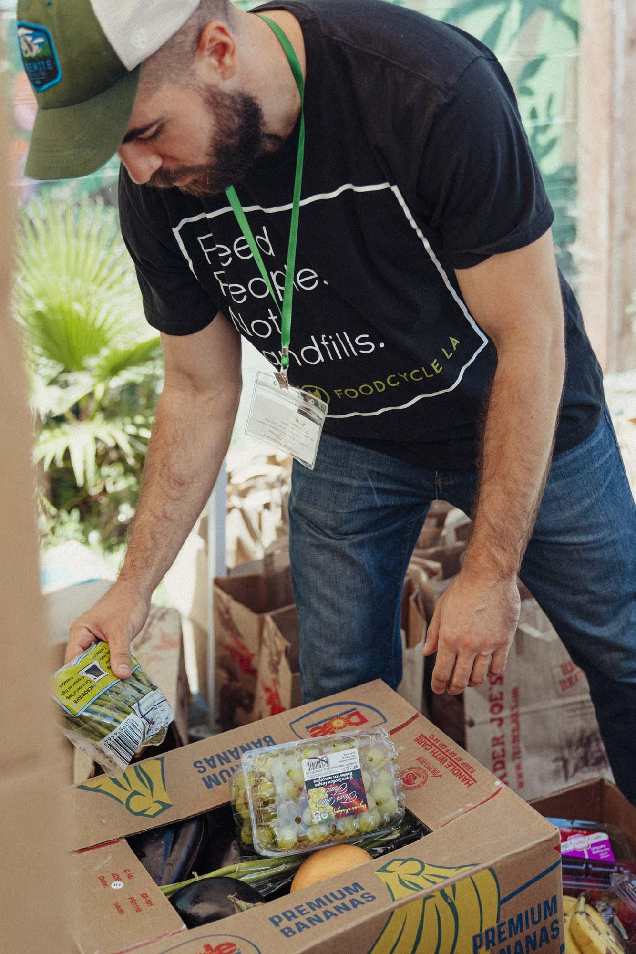
RESOURCES AVAILABLE: FoodCycle LA
Nonprofit food recovery service that serves the greater Los Angeles County area
Offers food donors (businesses) with a means to donate food to hungry people within the community
Picks up food that is ready to donate and deliver it to large food banks and small community-based distribution centers/pantries/soup kitchens
Food donation and safety training to business staff, setting up successful donation programs and maintains required documentation using Careit

Slide 14



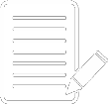
RESOURCES AVAILABLE: Careit
Post Food
Donations
Auto-Generated Contract
Maintains
Records
Free to download on iOS or Android
Designate food as pick-up or self-haul
Assign to FoodCycle or connect with previously contracted FRO
Careit auto-generates a downloadable written agreement between donor and nonprofit food recovery organization
Name and address of each donor, service or organization
Food types donated
Donation frequency
Quantity in lbs
You Can Use Careit to Meet SB 1383 Requirements (for free!)

Slide 15
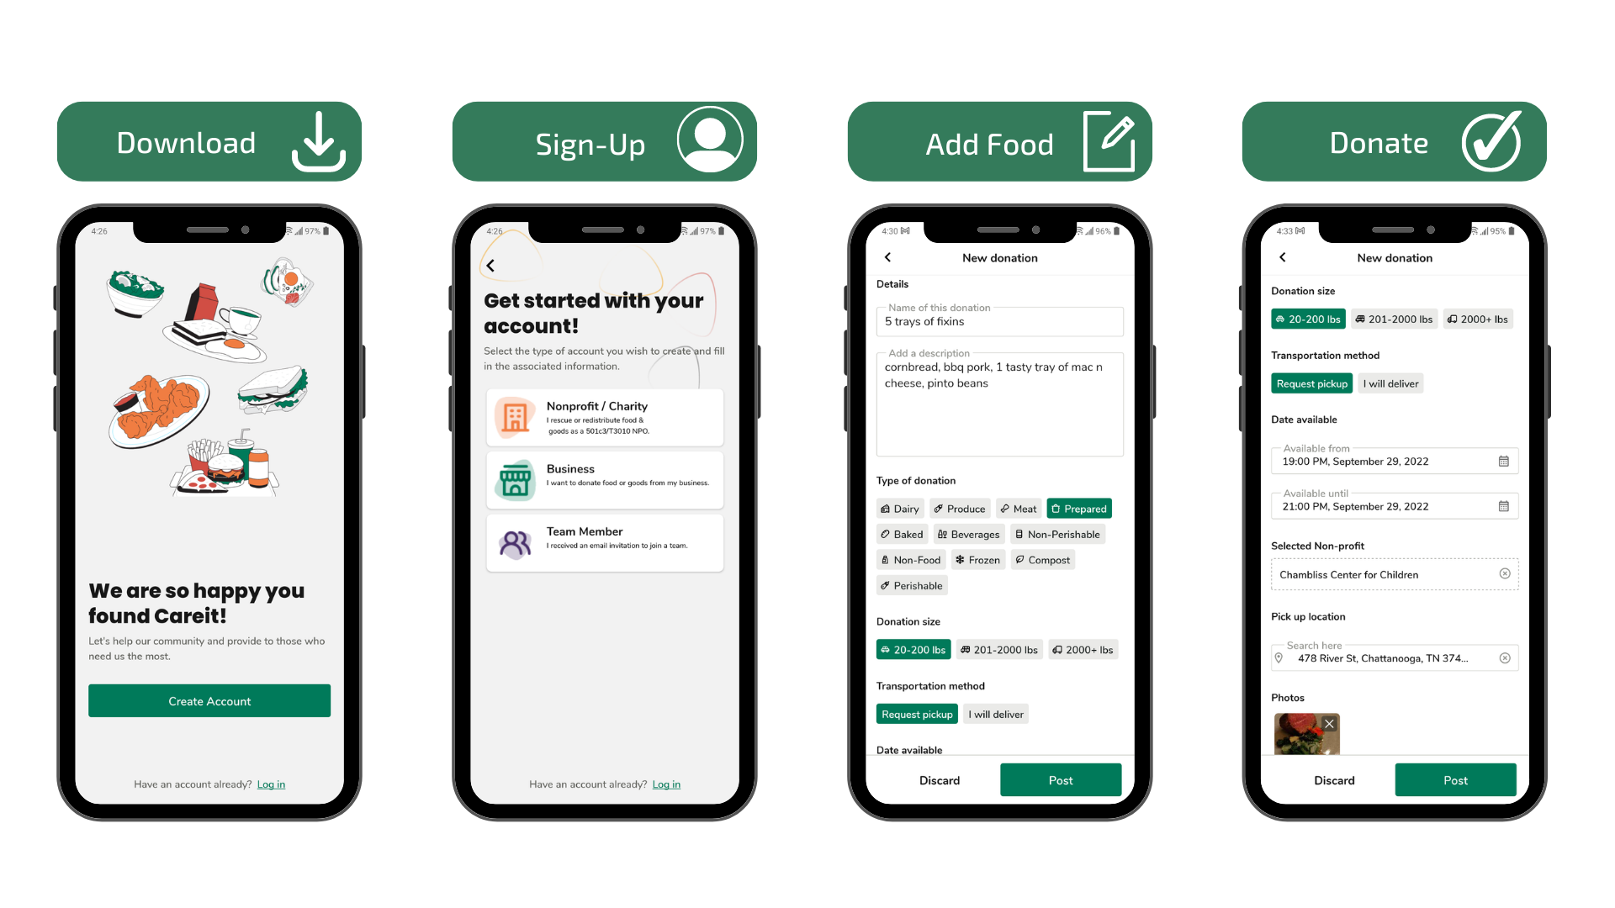
How to Set up a Careit Account

Slide 16
NEXT STEPS:
1
Contact ReCREATE to schedule a site visit
2
ReCREATE will provide education and outreach and refer applicable businesses to FoodCycle LA
3
FoodCycle LA will reach out to schedule additional site visit(s)
FoodCycle LA will provide deeper level of assistance in establishing/expanding a food donation program
4

Slide 17
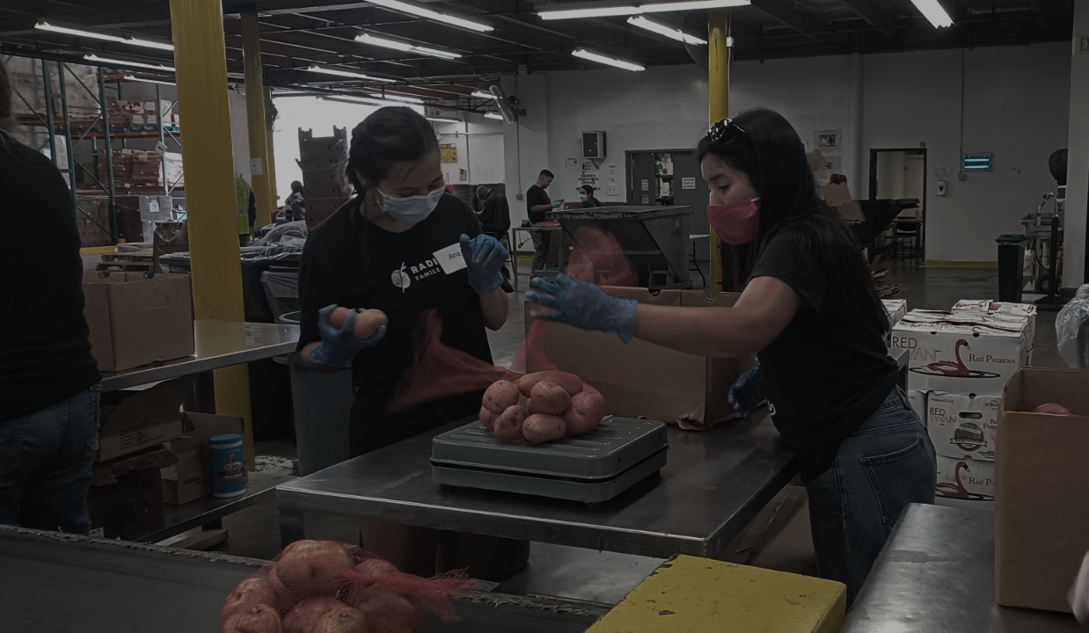
Contact Info
Kendra Schussel
Recycling Outreach Specialist II
ReCREATE Waste Collaborative
Kendra@recreatecollab.com
Integrated Waste Division City of Glendale, Dept Public Works
Recycle@glendaleca.gov
Nancy Beyda
Executive Director
FoodCycle LA
Nancy@foodcyclela.org
Alyson Schill
Creator, CEO
Careit
Alyson@careitapp.com

Slide 18
Questions?

